Slide 1

Building Trust in Modern Computing Platforms
Aritra Dhar
ETH Zurich
Notes:
Thanks for the introduction. And thanks for attending my talk. I am Aritra, Ph.D. student from ETH Zurich, and I am going to talk about a part of my doctoral thesis today which is about how to bring trust in modern computing platforms.

Slide 2
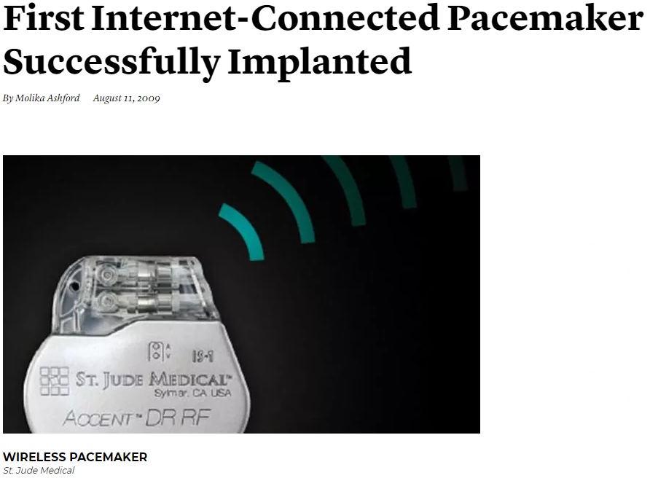
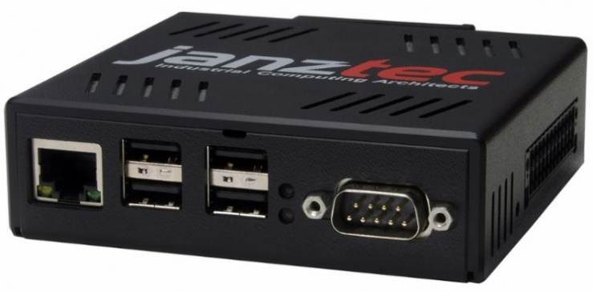

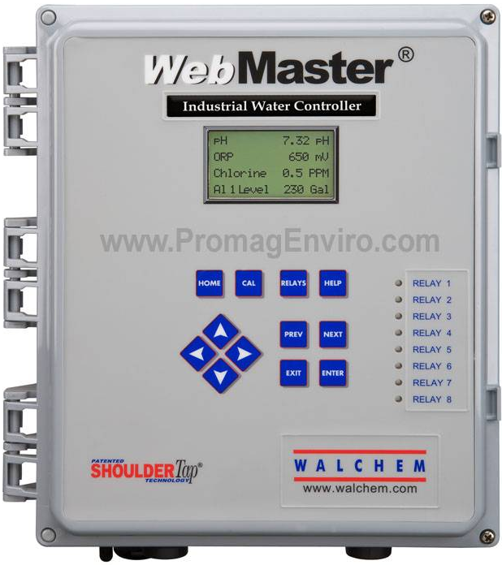
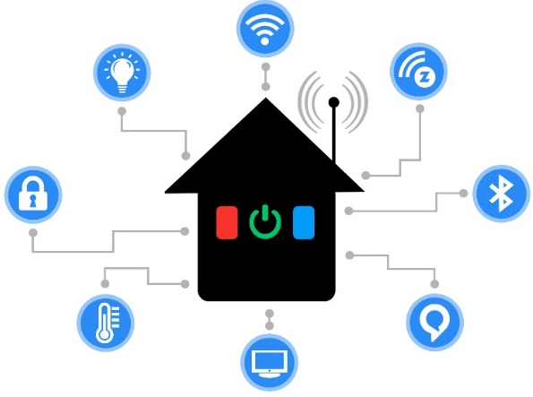
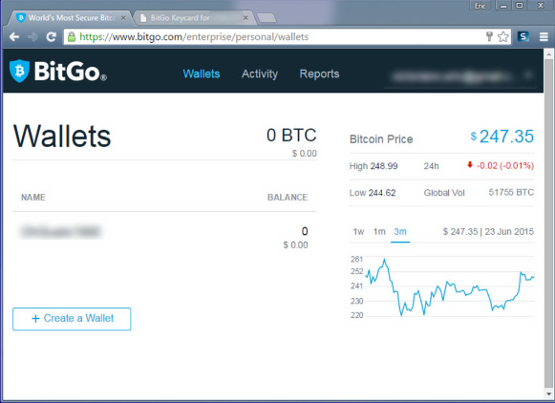
Remote safety/security-critical systems
Images are from janztec, wired, getty, controlbyweb
Notes:
First I will motivate you with some relevant examples that involves remote safety and security critical systems. Automation in industrial sector is getting more prevalent today and more and more of our critical infrastructure such a the electricity grid, gas pipelines, are monitored and actuated by these PLC or programmable logic controller. Compared to traditional PLCS, these are often web-enabled, i.e., they are networked attached and provide a web UI to access them. Other critical systems such as medical implants such as a pacemaker are becoming more and more smart so that a medical technicians can connect to them and monitor vitals or change some operational parameters. Smart homes are also another example where IoT devices report the current state of the home and one can actuate components. They also provide web or mobile enabled UI. Other, more traditional use cases could be financial transaction. The most common are banking, however cryptocurrency is on the rise and unlike a brick and mortar bank, they rely on the web services.

Slide 3
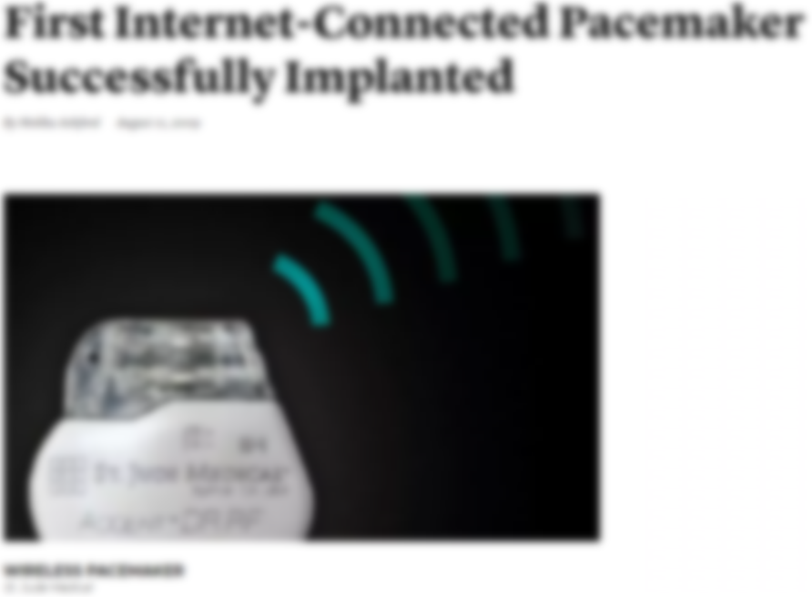
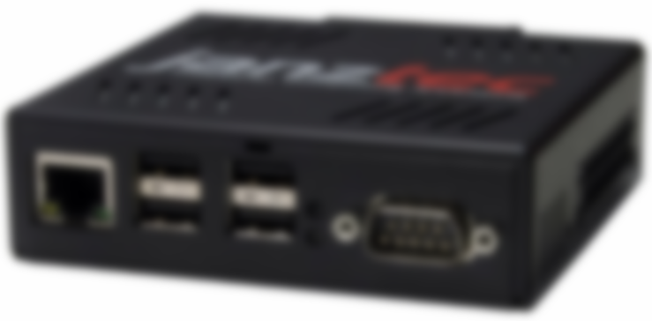
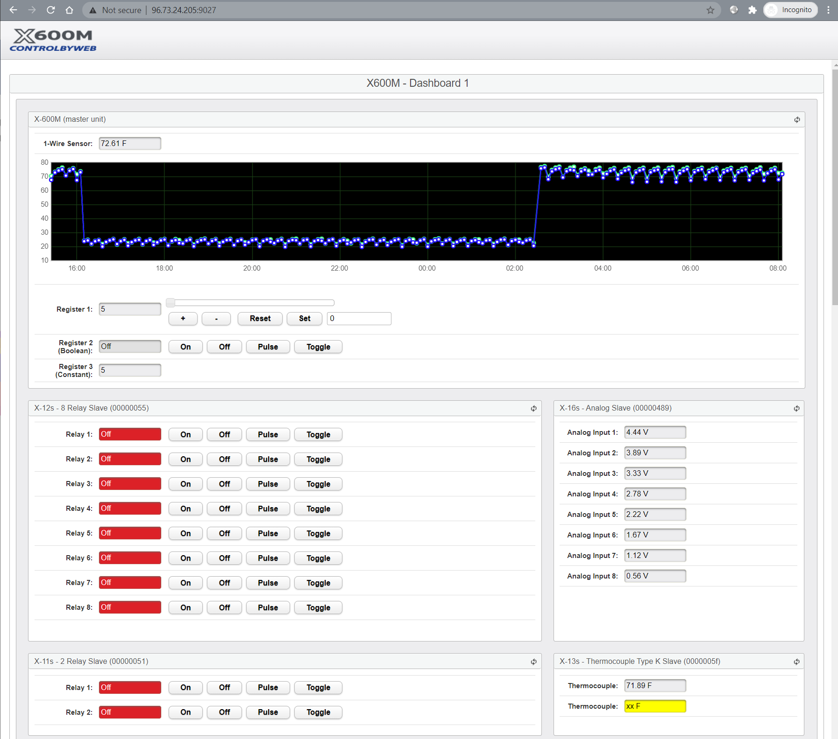
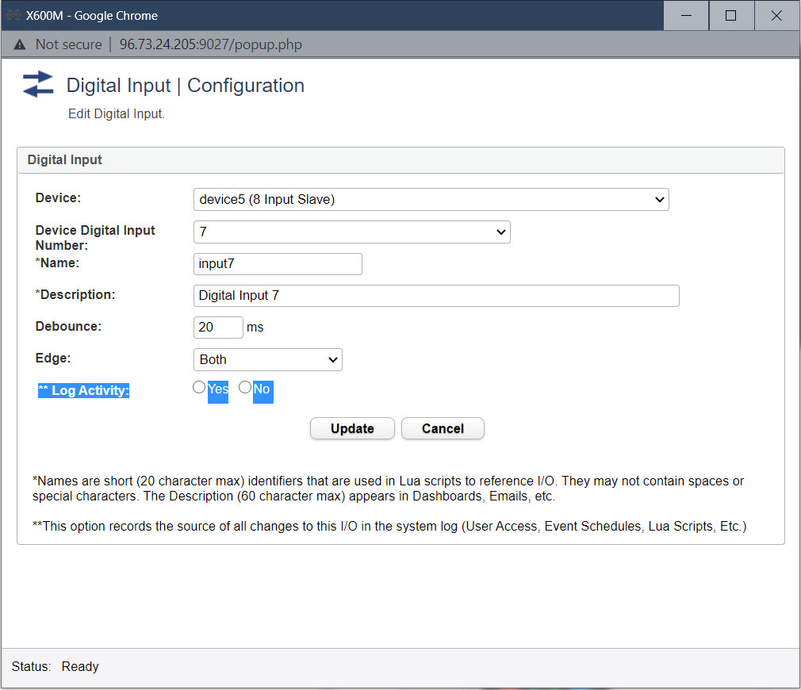



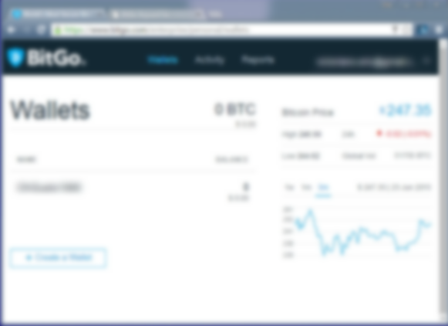
Remote safety/security-critical systems
Images are from janztec, wired, getty, controlbyweb
Notes:
All of they enable users to use their platform which are off the shelf computers to access their browser to access these services. Here is one of the example with the web enabled PLC made by controlby web. That provide rich UI interfaces that not only provide a many different way to input to the system but to interpret the output. And these are very critical for the proper operation of these devices.

Slide 4






Large Attack Surface
25.16M
20.92M
2M
36.68M
600K
71K
CPU microcode
Device firmware
Device drivers
….
Notes:
As the most of the enc users rely on the off the shelf software and hardware such as the browsers and OS/ hypervisors. These are complex software and have millions of lines of code. Which also indicates that they have a large attack surface. And remember that this is just the tip of the iceberg, most of the processor microcode, device drivers and firmware are proprietary. E.g., android is open source but most of the code bases are preoperatory SoC firmware .

Slide 5
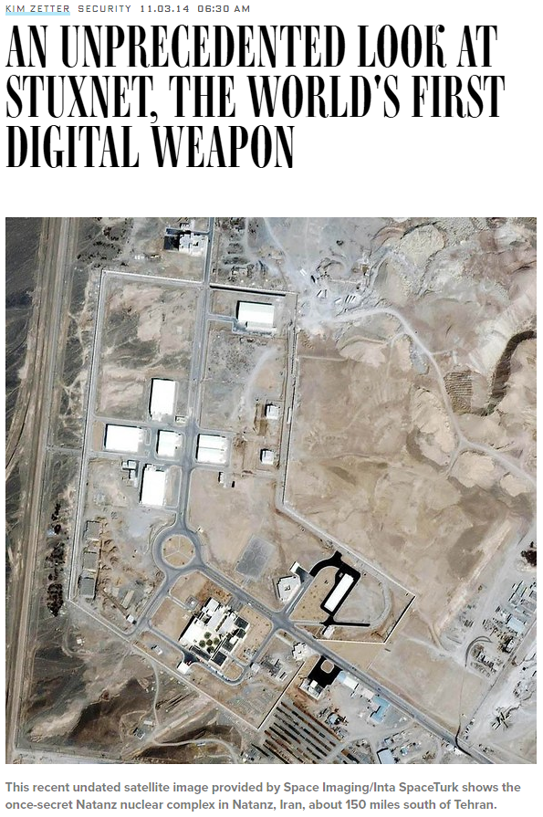
Attacks
Images are from wired, csmonitor, heimdalsecurity
Notes:
Over the time, we have seen a number of attacks that exploits such vulnerability in the OS, device drivers, device firmware such as routers etc.

Slide 6
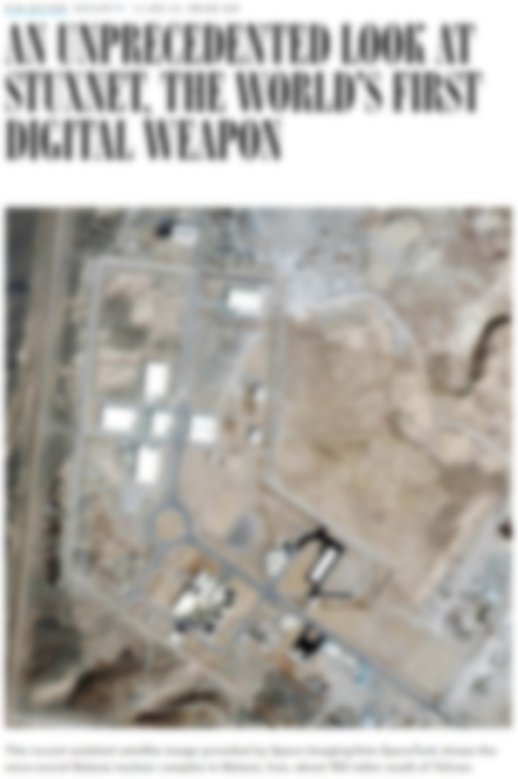
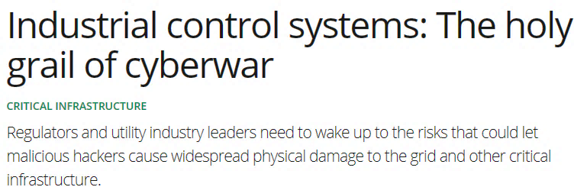
Attacks
Images are from wired, csmonitor, heimdalsecurity
Notes:
Safety critical systems such as the industrial controller are also targets of increased attacks due to their large complexity and usage of commodity hardware and software

Slide 7
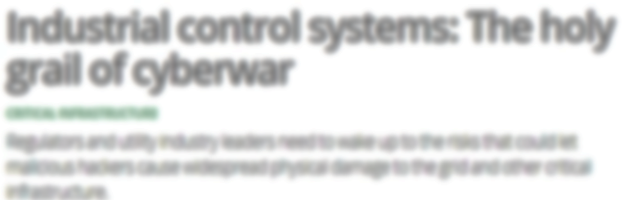
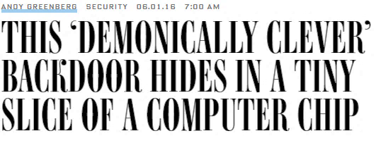
Attacks
Images are from wired, csmonitor, heimdalsecurity
Notes:
Not only the complexity in the software but complexity in the hardware also opens up a large attack surface as a large number of hardware components are squished into a small space and there is no possible way to verify and sophisticated supply chain attach such as an analog malware

Slide 8
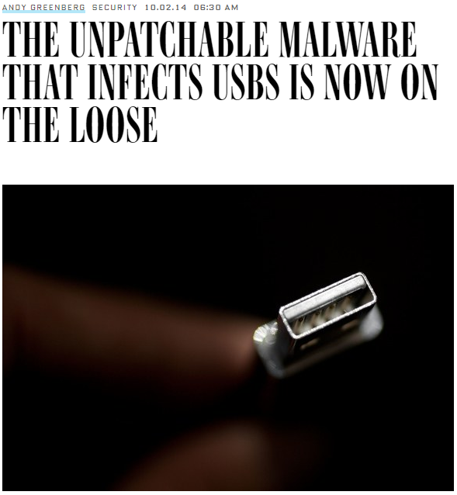
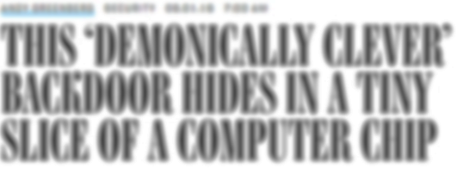
Attacks
Images are from wired, csmonitor, heimdalsecurity
Notes:
BadUSB is also one of the example where a sophisticated supply chain attack can implant malware into the USB and sniff all the sensitive data

Slide 9
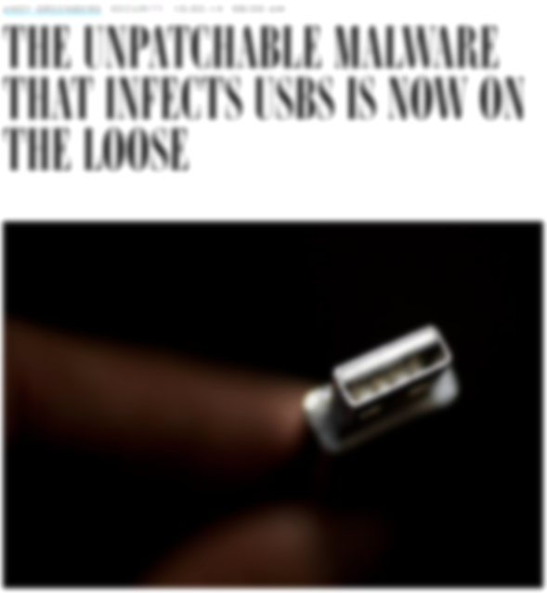
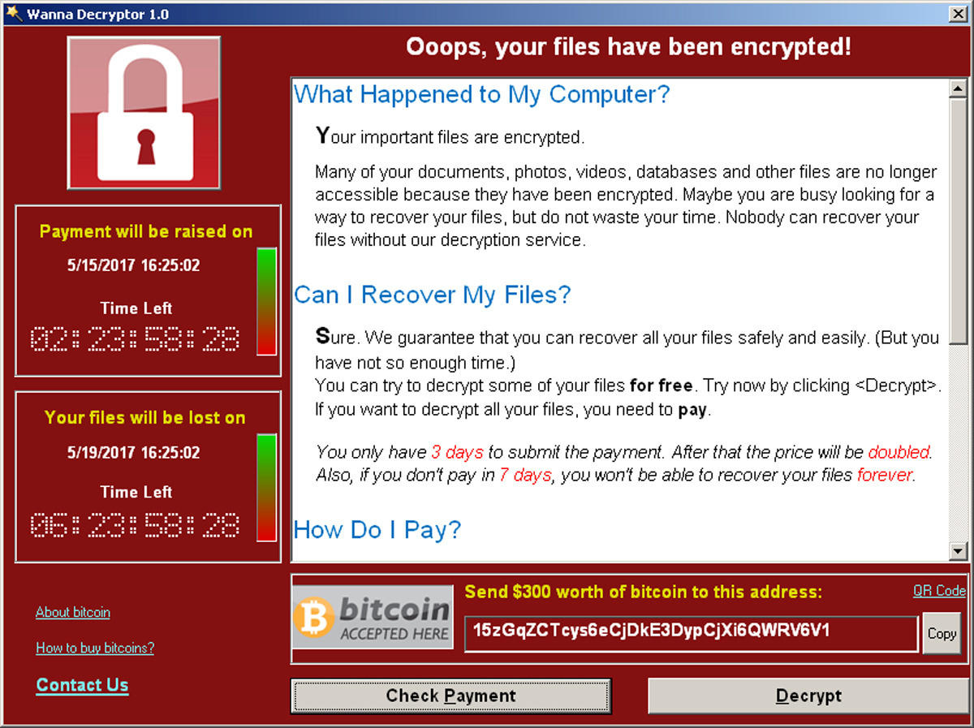
Attacks
Images are from wired, csmonitor, heimdalsecurity
Notes:
And of course, one of the most memorable attacks is the wanncry ransomeare attack that exploits an outdated network protocol in Windows XP and cripple entire NHS, the British healthcare systems

Slide 10



Concrete Attack Scenario
Remote device
Heart beat
75
Insulin (U)
177
Basal rate (U/Hr)
0.025
Low limit (mg/dL)
60
High limit (mg/dL)
105
Program
Cancel
Aritra Dhar
Notes:
Now, we as security researchers are well aware of the complexity of software systems and the attack surface they open up. However, oftentimes, its not clear how these attacks can affect our data to day lives. I will now provide one such concrete attack scenario that focuses on network-controlled medical implants. Two such examples are pacemakers and insulin pumps where the doctor can change vital parameters.

Slide 11

Concrete Attack Scenario
Remote device
Heart beat
75
Insulin (U)
177
Basal rate (U/Hr)
0.025
Low limit (mg/dL)
60
High limit (mg/dL)
105
Program
Cancel
Aritra Dhar
Notes:
The attacker who compromises the entire software stack, i.e., the OS, VM, browser can …

Slide 12
Concrete Attack Scenario
Remote device
Heart beat
75
65
Insulin (U)
177
Basal rate (U/Hr)
0.025
Low limit (mg/dL)
60
High limit (mg/dL)
105
Program
Cancel
Aritra Dhar
Notes:
The attacker can not only see the input parameter, but also introduce arbitrary modifications into them, resulting in the misconfiguration in these implants that have serious on

Slide 13





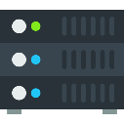

Remote Trusted path
User
IO devices
Host
Remote server
Notes:
Trusted path is an umbrella term that denotes the integrity and confidentiality of the channel between the user IO devices and the target TCB, remote trusted path is an extension where all the communication goes over the untrusted local platform and the network.

Slide 14





Trusted Execution Environment (TEE)
TCB
App
App
App
App
App
Enclave
Operating System
Operating System
Dev
DRAM
CPU
Dev
DRAM
CPU
TCB
TCB
Traditional platforms
Intel SGX
OS still manages devices
Trust on first use for remote attestation
Static HW TCB
Notes:
Trusted Execution Env or TEE solves some of this problem by reducing the TCB. In traditional platforms, the TCB consists of the application, OS and the hardware. Where in TEE, the application or the enclave is isolated from the OS and other apps by security primitives implemented by the micro processor.

Slide 15



Traditional CPU-centric Model
Memory
USB
PCI
TB
SATA
Security Monitor (SM)
Processor

Slide 16

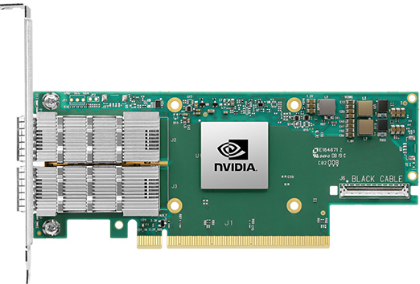
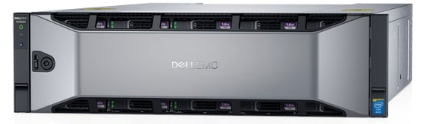
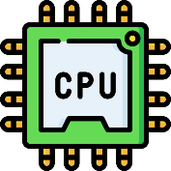
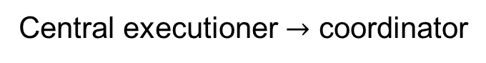
Disaggregated computing
Central executioner $→$ coordinator
Images are from nVidia, Dell, Mellanox official websites

Slide 17





Thesis Contribution
IntegriKey (2017, eprint: 2017/1245)
ProtectION (NDSS 2020)
IntegriScreen (2018, arXiv:2011.13979)
Remote trusted path application

Slide 18
Thesis Contribution
IntegriKey (2017, eprint: 2017/1245)
ProtectION (NDSS 2020)
IntegriScreen (2018, arXiv:2011.13979)
Remote trusted path application
ProximiTEE (CODASPY 2020)

Slide 19

Thesis Contribution
IntegriKey (2017, eprint: 2017/1245)
ProtectION (NDSS 2020)
IntegriScreen (2018, arXiv:2011.13979)
Remote trusted path application
Dedicated Security Chips in the Age of Secure Enclaves (IEEE S&P magazine 2020)
ProximiTEE (CODASPY 2020)

Slide 20





Thesis Contribution
PIE (2020, arXiv:2010.10416)
IntegriKey (2017, eprint: 2017/1245)
ProtectION (NDSS 2020)
IntegriScreen (2018, arXiv:2011.13979)
Peripheral deriver
Remote trusted path application
Dedicated Security Chips in the Age of Secure Enclaves (IEEE S&P magazine 2020)
ProximiTEE (CODASPY 2020)

Slide 21
Thesis Contribution
PIE (2020, arXiv:2010.10416)
IntegriKey (2017, eprint: 2017/1245)
ProtectION (NDSS 2020)
IntegriScreen (2018, arXiv:2011.13979)
Peripheral deriver
Remote trusted path application
Dedicated Security Chips in the Age of Secure Enclaves (IEEE S&P magazine 2020)
ProximiTEE (CODASPY 2020)

Slide 22
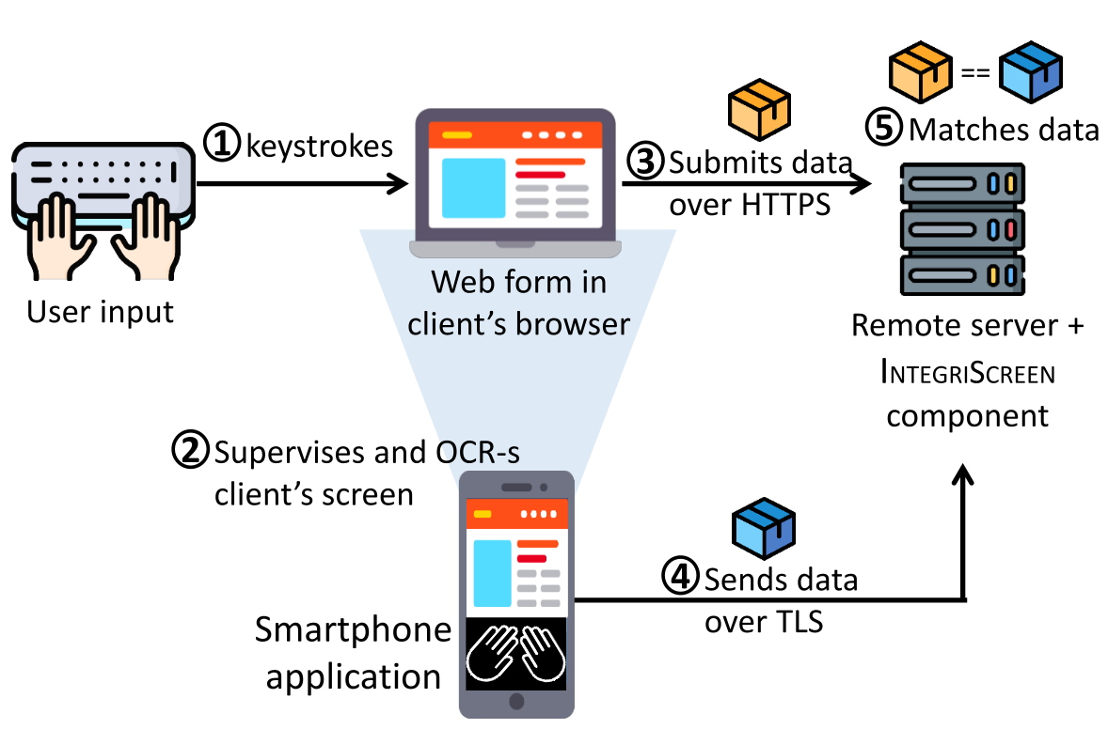
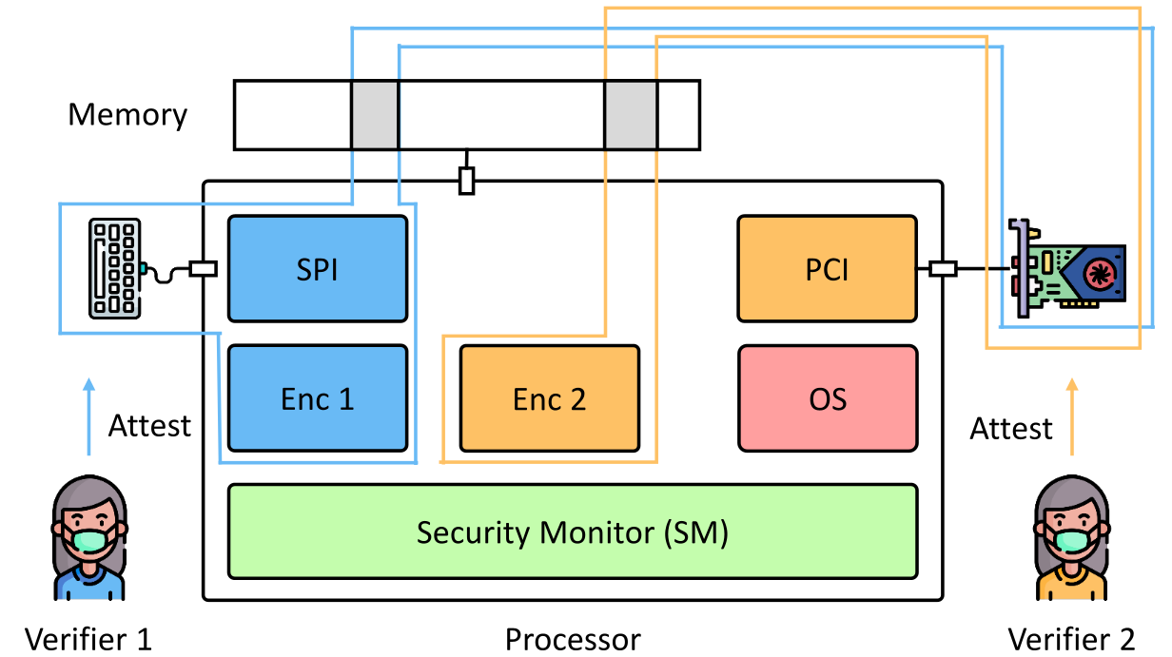
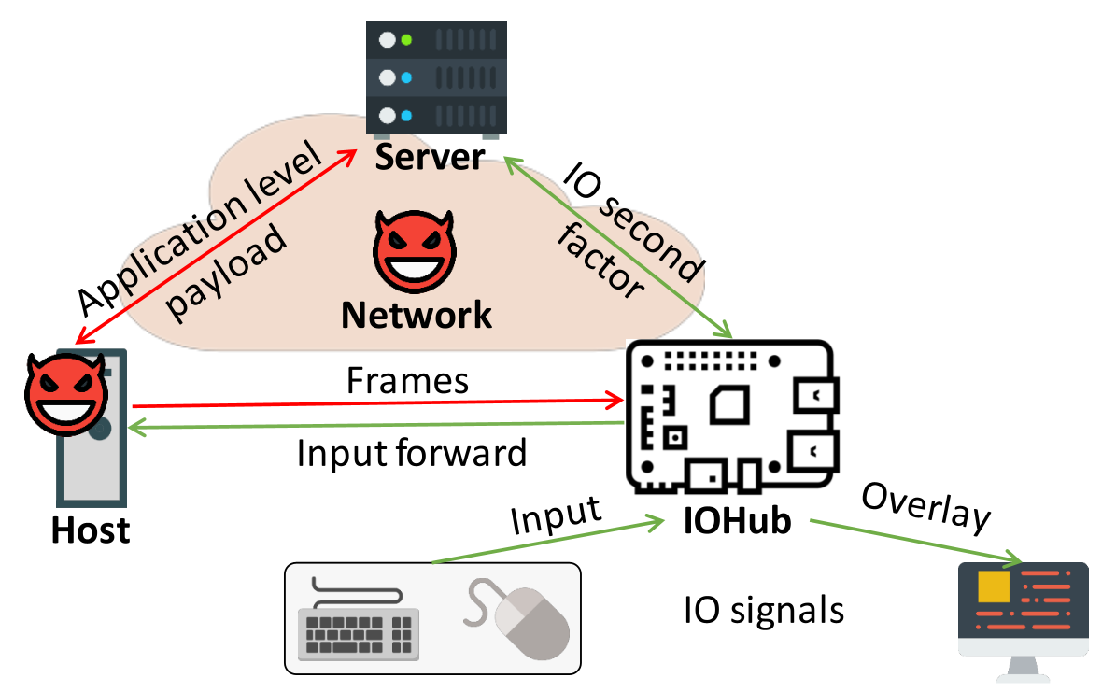
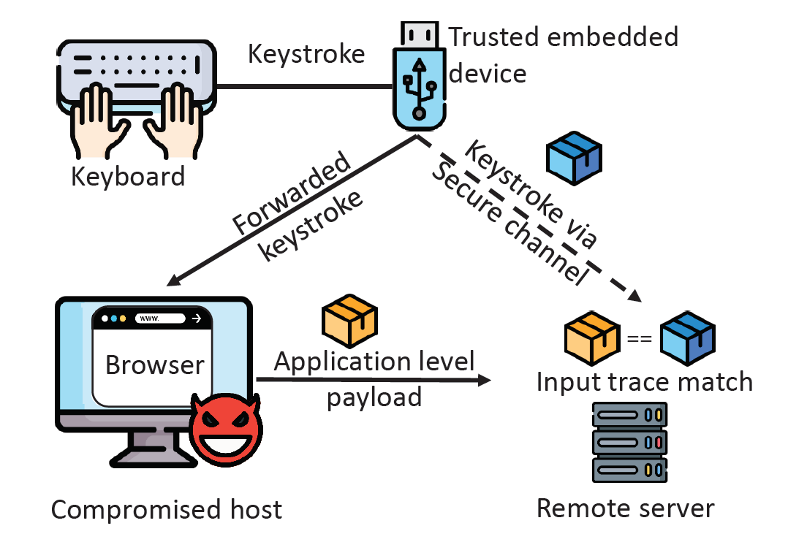
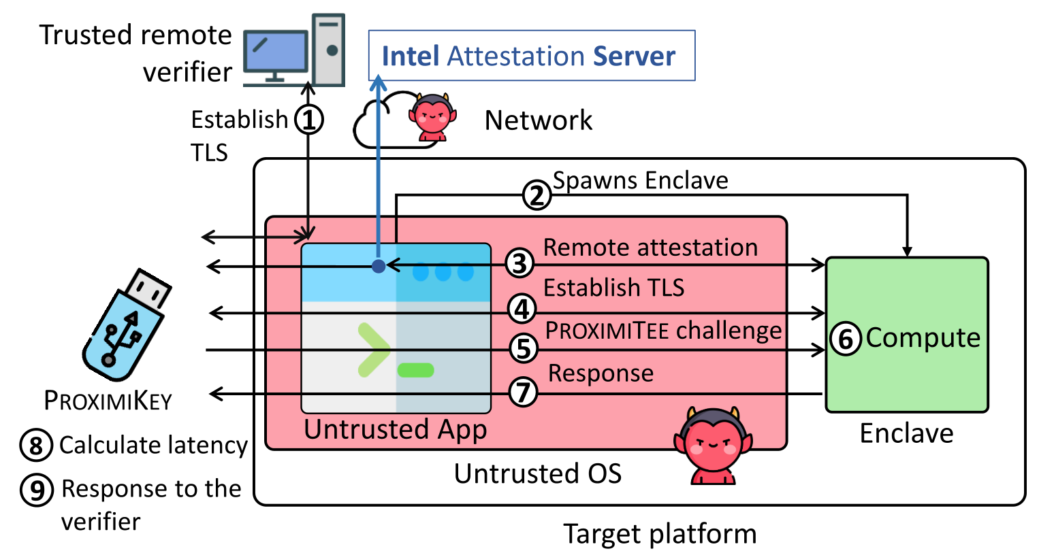
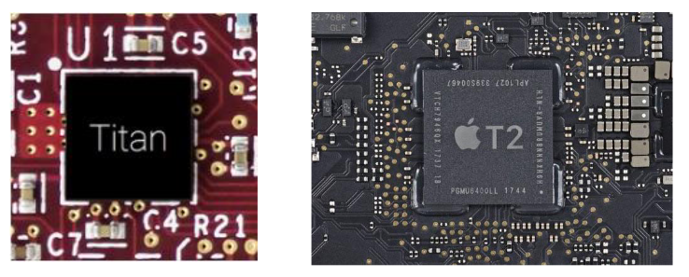
Thesis contribution
Ad-Hoc trusted path solutions
IntegriKey (2017, eprint: 2017/1245)
IntegriScreen (2018, arXiv:2011.13979)
Fundamentals of trusted path
ProtectIOn (NDSS 2020)
Assertion on identity of a platform
ProximiTEE (CODASPY 2020)
External security chips for TEEs
Hardware assisted security (IEEE Security & Privacy 2020)
Reconfigurable HW/SW TCB
PIE (2020, arXiv:2010.10416)
Aritra Dhar

Slide 23
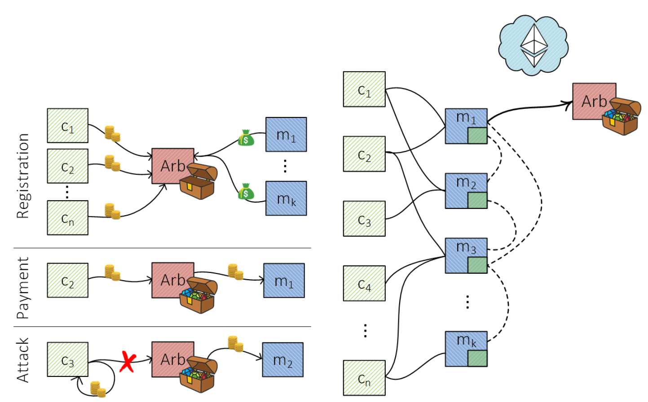
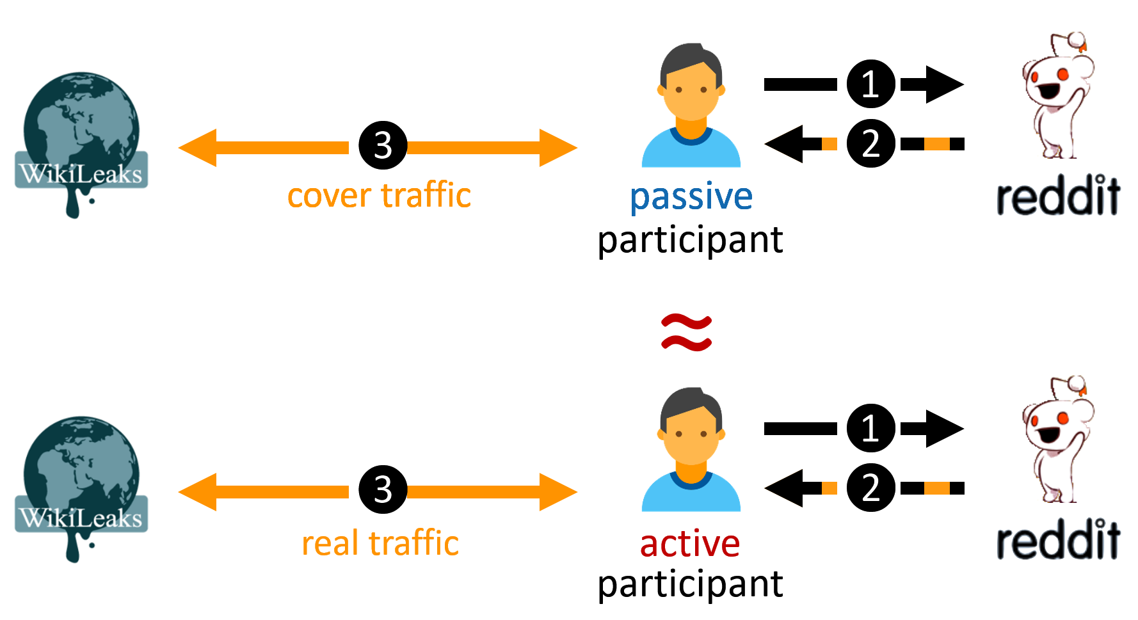
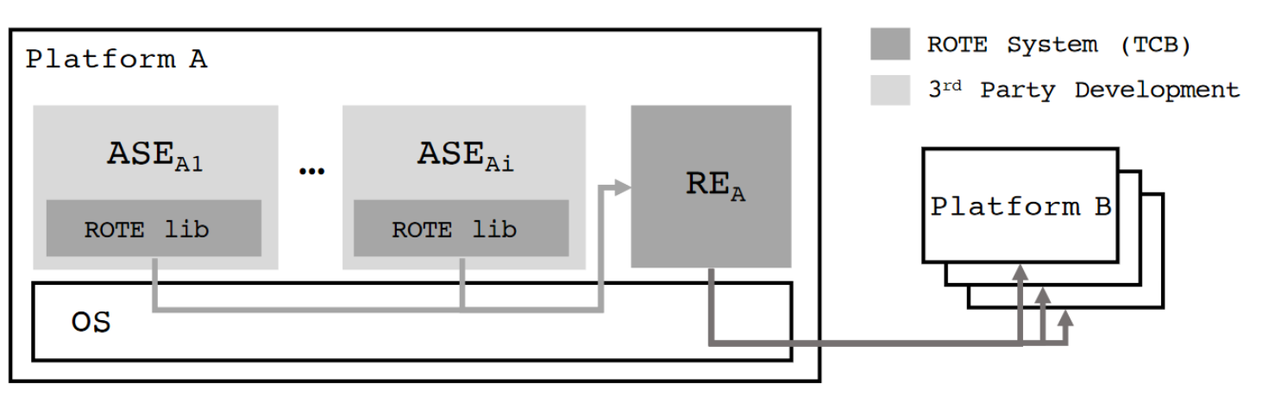
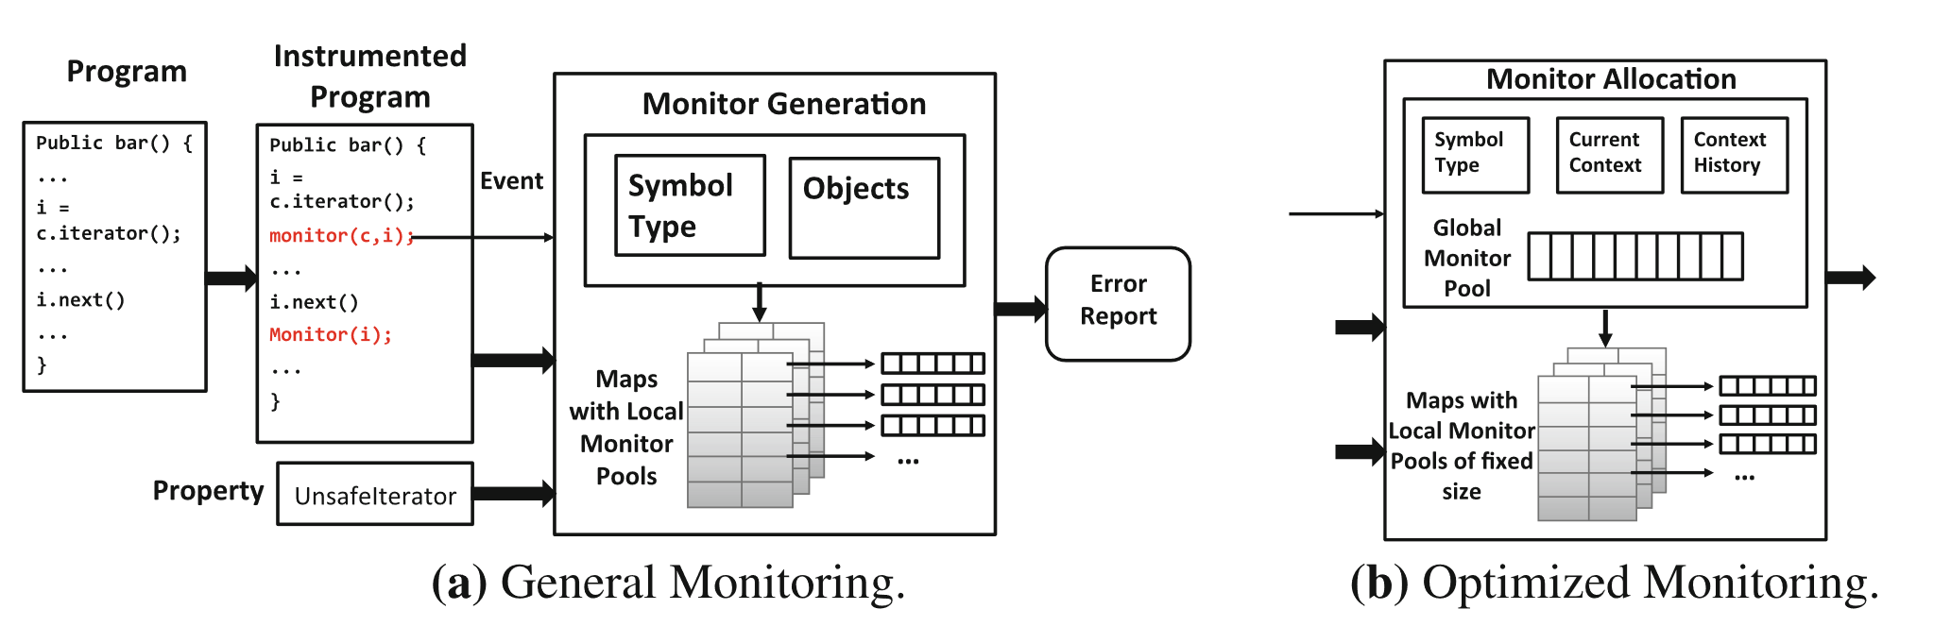
Other contributions
Fast off-chain payments
Snappy (NDSS 2020)
Anonymous communication
CoverUp (NSDI 2019)
Monitoring of type-state properties
Metis (RV 2018)
Rollback protection for SGX
ROTE (USENIX 2017)

Slide 24
Today’s talk
Ad-Hoc trusted path solutions
IntegriKey (2017, eprint: 2017/1245)
IntegriScreen (2018, arXiv:2011.13979)
Fundamentals of trusted path
ProtectIOn (NDSS 2020)
Establishing identity of a platform
ProximiTEE (CODASPY 2020)
External security chips for TEEs
Hardware assisted security (IEEE Security & Privacy 2020)
Reconfigurable HW/SW TCB
PIE (2020, arXiv:2010.10416)
Aritra Dhar

Slide 25
Today’s talk
Ad-Hoc trusted path solutions
IntegriKey (2017, eprint: 2017/1245)
IntegriScreen (2018, arXiv:2011.13979)
Fundamentals of trusted path
ProtectIOn (NDSS 2020)
Establishing identity of a platform
ProximiTEE (CODASPY 2020)
External security chips for TEEs
Hardware assisted security (IEEE Security & Privacy 2020)
Reconfigurable HW/SW TCB
PIE (2020, arXiv:2010.10416)

Slide 26
Today’s Talk
PIE (2020, arXiv:2010.10416)
IntegriKey (2017, eprint: 2017/1245)
ProtectION (NDSS 2020)
IntegriScreen (2018, arXiv:2011.13979)
Peripheral deriver
Remote trusted path application
Dedicated Security Chips in the Age of Secure Enclaves (IEEE S&P magazine 2020)
ProximiTEE (CODASPY 2020)

Slide 27
ProtectIOn setting
Remote trusted path application

Slide 28







Solution 1: Transaction Confirmation Device
Remote device
Heart beat
75
Insulin (U)
177
Basal rate (U/Hr)
0.025
Low limit (mg/dL)
60
Android Protected Confirmation
You are going to program
Heart beat 75
Insulin 177U
Basal rate 0.025 U/Hr
Low level 60 mg/dL
High level 105 mg/dL
And more ……
High limit (mg/dL)
105
Program
Cancel

Slide 29



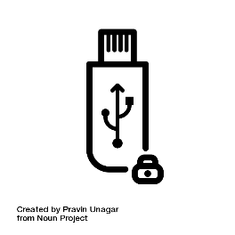
Solution 2: Input Signing
Remote device
Heart beat
75
Insulin (U)
177
Heart beat 75
Insulin 177U
Basal rate 0.025 U/Hr
Low level 60 mg/dL
High level 105 mg/dL
Basal rate (U/Hr)
0.025
Low limit (mg/dL)
60
Trusted embedded device
High limit (mg/dL)
105
Program
Cancel

Slide 30



Display manipulation attack
177
177
Insulin
17
7
1777
Insulin
177
User sees 177
Device records 1777
Host sends 1777
IntegriKey

Slide 31
Observation 1
The lack of output integrity – the render of user inputs on the screen – compromises input integrity.

Slide 32

Solution 3: Overlay
Remote device
Remote device
Heart beat
Heart beat
75
Insulin (U)
Insulin (U)
177
Basal rate (U/Hr)
Basal rate (U/Hr)
0.025
Low limit (mg/dL)
Low limit (mg/dL)
60
High limit (mg/dL)
High limit (mg/dL)
105
Program
Cancel
Program
Cancel

Slide 33
Overlay: Output Manipulation
Remote device
Remote device
Heart beat
Insulin (U)
Insulin (U)
Heart rate
Basal rate (U/Hr)
Basal rate (U/Hr)
Low limit (mg/dL)
Low limit (mg/cc)
High limit (mg/dL)
High limit (mg/cc)
Program
Cancel
Program
Cancel

Slide 34

Overlay: Output Manipulation
Remote device
Insulin (U)
177
Heart rate
75
Basal rate (U/Hr)
0.025
Low limit (mg/cc)
6000
High limit (mg/cc)
10500
Program
Cancel

Slide 35
Observation 2
If the protected output is provided out-of-context,
users are more likely not to verify it.
Therefore input integrity can be violated.

Slide 36
Overlay: Early Form Submission Attack
Remote device
Heart beat
75
Textbox in focus
Insulin (U)
17
Basal rate (U/Hr)
0.025
Fidelius
Trusted overlay from FPGA
Low limit (mg/dL)
60
High limit (mg/dL)
105
OS triggers click
Program
Cancel

Slide 37
Observation 3
If not all the modalities of inputs are secured simultaneously, none of them can be fully secured.

Slide 38






Requirements
The lack of output integrity – the render of user inputs on the screen – compromises input integrity.
Inter-dependency between Input and output

Slide 39
Requirements
If not all the modalities of inputs are secured simultaneously, none of them can be fully secured.
All modalities of input

Slide 40
Requirements
If the protected output is provided out-of-context, users are more likely not to verify it. Therefore input integrity can be violated.
Low cognitive load

Slide 41
Requirements
Low TCB and easy deploy

Slide 42
Requirements

Slide 43








ProtectIOn
Low TCB + fast deployment
Input modalities
IOHub

Slide 44
IO Integrity – Overlay Generation
Remote device
Insulin (U)
Heart rate
Simultaneous IO
Basal rate (U/Hr)
Low limit (mg/cc)
High limit (mg/cc)
Program
Cancel
<form action=“/some_action”, signature = “0x45AB…”, id = “0x0ab”>

Slide 45


IO Integrity – Overlay Generation
Simultaneous IO

Slide 46
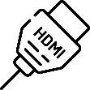

IO Integrity – Overlay Generation
Remote device
Verified UI from secure_site.io
Insulin (U)
Heart rate
Simultaneous IO
Basal rate (U/Hr)
Low limit (mg/cc)
High limit (mg/cc)
Program
Cancel

Slide 47

IO Integrity – Input
Remote device
Verified UI from secure_site.io
Insulin (U)
75
Heart rate
177
Simultaneous IO
Basal rate (U/Hr)
0.025
Low limit (mg/cc)
60
High limit (mg/cc)
105
Program
Cancel

Slide 48
Grabbing User Attention
Output Integrity: Low cognitive load
Several existing mechanisms
Low cognitive load
Put 1 in front of all inputs

Slide 49
Grabbing User Attention
Output Integrity: Low cognitive load
Several existing mechanisms
Lightbox
Low cognitive load
Put 1 in front of all inputs

Slide 50
Grabbing User Attention
Output Integrity: Low cognitive load
Several existing mechanisms
Lightbox
Highlight
Low cognitive load
Put 1 in front of all inputs

Slide 51
Grabbing User Attention
Output Integrity: Low cognitive load
Several existing mechanisms
Lightbox
Highlight
Freezing
Low cognitive load
Put 1 in front of all inputs

Slide 52
Grabbing User Attention
Output Integrity: Low cognitive load
Several existing mechanisms
Lightbox
Highlight
Freezing
Combination
Low cognitive load
Put 1 in front of all inputs

Slide 53
Grabbing User Attention
Output Integrity: Low cognitive load
Several existing mechanisms
Lightbox
Highlight
Freezing
Combination
How to determine when to engage?
Track pointer
Mouse movement on the overlay
Low cognitive load

Slide 54
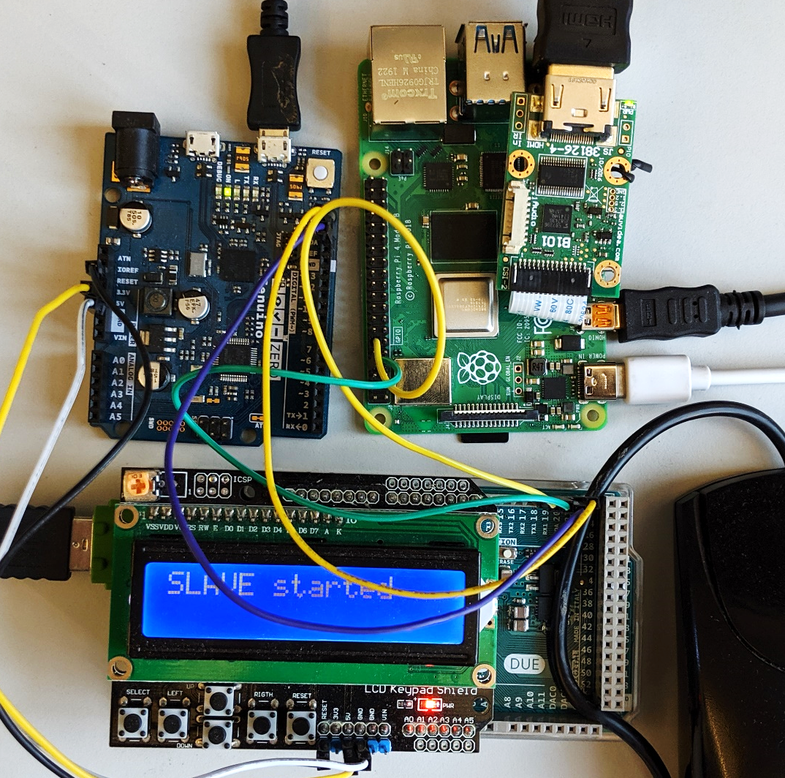

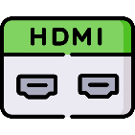

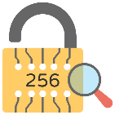





Prototype and TCB
Low TCB
Fast deployment
25.16M
20.92M
1.9K
2M
3.5K
71K
893
600K
121K
36.68M

Slide 55

Performance
Display latency: 21.67 ms
~46 fps
Mouse latency: 250 $μs$
Keyboard latency: 170 $μs$
Pointer detection accuracy: 0.997

Slide 56
ProtectIOn $→$ProximiTEE
Remote trusted path application

Slide 57
ProtectIOn $→$ProximiTEE
Remote trusted path application
Identity of the platform

Slide 58







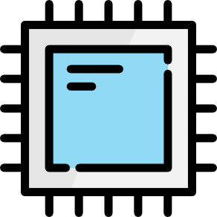


Motivation: Remote Attestation
Sensitive data
Enclave
A legitimate platform
A legitimate enclave
Platform PK
Report
Challenge
CPU
Verifier
Signed report
Notes:
Assume the enclave is accessing your sensitive medical data. As an user you want to know if you are actually executing the actual enclave coming from a reputed software developer or the attacker is impersonating as the legitimate software and may steal your data. To protect against this, TEEs provide remote attestation that enables the user to verify the software….
The processor has an embedded key that is burned into the fuses during the manufacturing process. The key proves that it is a legitimate intel processor.
The attestation report not only contain the code, stack and heap, but also the micro code version number to make sure that attesting platform is using the updated version of the CPU microcode.
After attestation the verifier asserts that 1) she is communicating with a legitimate intel platform and 2) the enclave code is legitimate -- EPID
Problem: a platform, not a specific one

Slide 59





Common issue: Relay Attacker
Challenge
App
Enclave
OS
Signed report
CPU
Verifier
Target platform
Relay challenge
Signed report
App
Enclave
OS
CPU
Assign secret
Attacker’s platform
Notes:
Relay attacker,
Platforms could be geographically separated.
Verifier still gets the proper output – a platform and a legitimate enclave.
She attest the attacker’s platform rather that the target platform

Slide 60

Our Contribution: Relay Attack Implications
App
Enclave
Physical access
Privilege escalation
Undermine platform maintenance
Defer patch
Secure target platform
Insecure attacker’s platform
OS
CPU

Slide 61
Distinguishing is hard
App
Enclave
OS
CPU
Verifier
Target platform
App
Enclave
OS
CPU
Attacker’s platform

Slide 62

Our Contribution: Auxiliary Device
App
Enclave
OS
CPU
ProximiKey
Verifier
Target platform
App
Enclave
OS
CPU
Attacker’s platform

Slide 63
ProximiTEE
App
Enclave
Establish secure channel
OS
CPU
ProximiKey
Verifier
Target platform
App
Enclave
OS
CPU
Attacker’s platform

Slide 64
ProximiTEE
App
Enclave
OS
CPU
ProximiKey
Target platform

Slide 65
ProximiTEE
App
Enclave
Initiate remote attestation
OS
Report + platform pk
CPU
ProximiKey
Target platform

Slide 66
ProximiTEE
App
Enclave
Secure channel
OS
CPU
ProximiKey
Target platform

Slide 67
ProximiTEE
Calculate latency
Determine proximity
App
Enclave
Challenge
OS
Response
CPU
ProximiKey
Target platform

Slide 68
ProximiTEE
Verifier
App
Enclave
OS
App
Enclave
CPU
ProximiKey
OS
Target platform
CPU
Attacker’s platform

Slide 69
ProximiTEE
Latency > threshold
Possible relay attack
App
Enclave
OS
CPU
Verifier
Target platform
App
Enclave
OS
CPU
Attacker’s platform

Slide 70



ProximiTEE
App
Enclave
Signed proximity result
OS
CPU
Verifier
Signed report
Target platform
A specific legitimate platform
App
Enclave
A legitimate enclave running on that platform
OS
CPU
Attacker’s platform

Slide 71
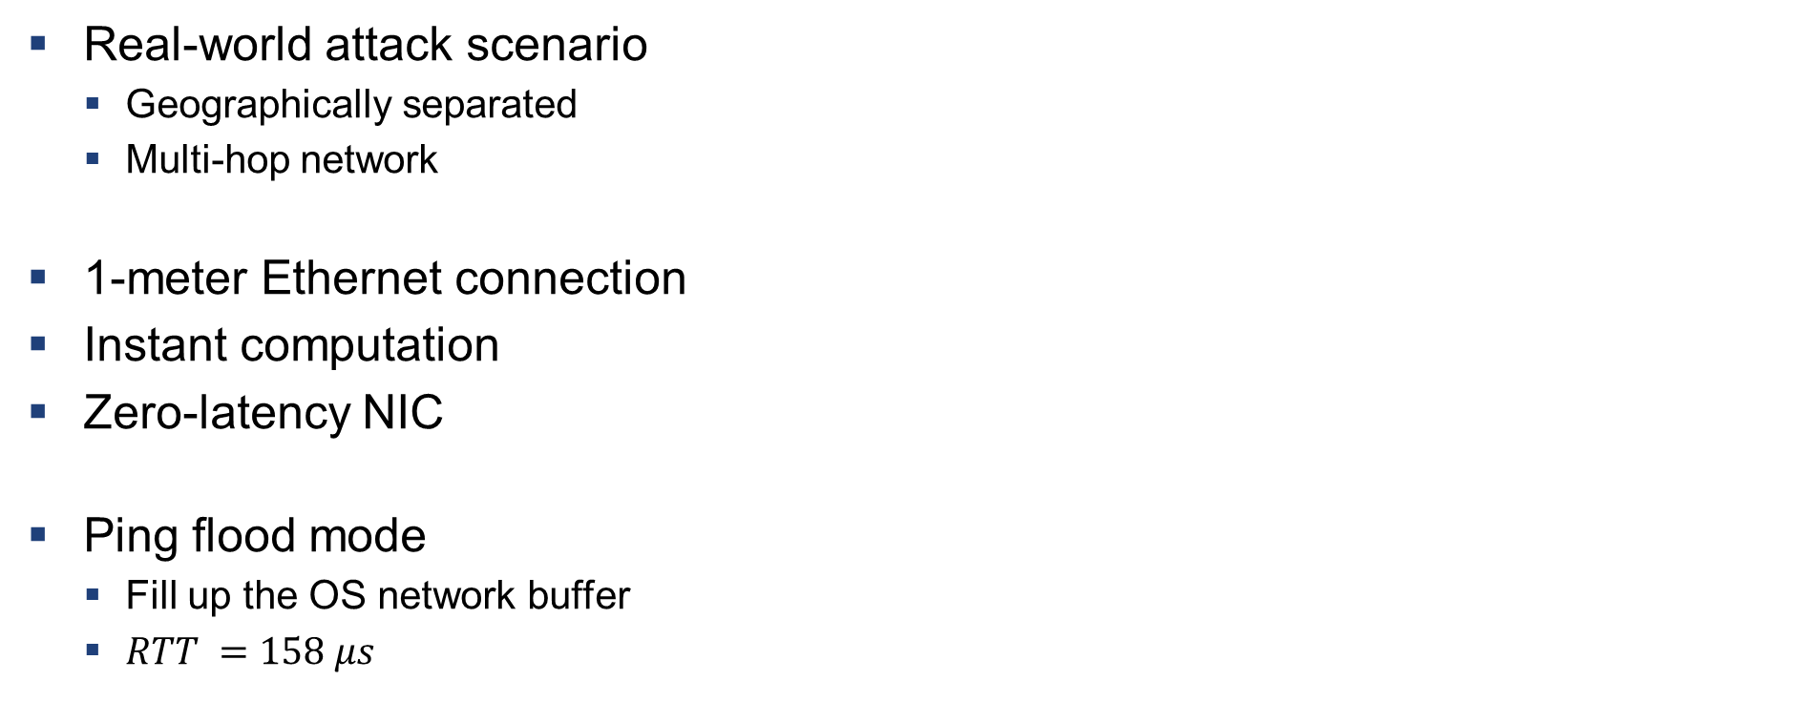
Simulating a Powerful Attacker
Real-world attack scenario
Geographically separated
Multi-hop network
1-meter Ethernet connection
Instant computation
Zero-latency NIC
Ping flood mode
Fill up the OS network buffer
$RTT =158 μs$

Slide 72
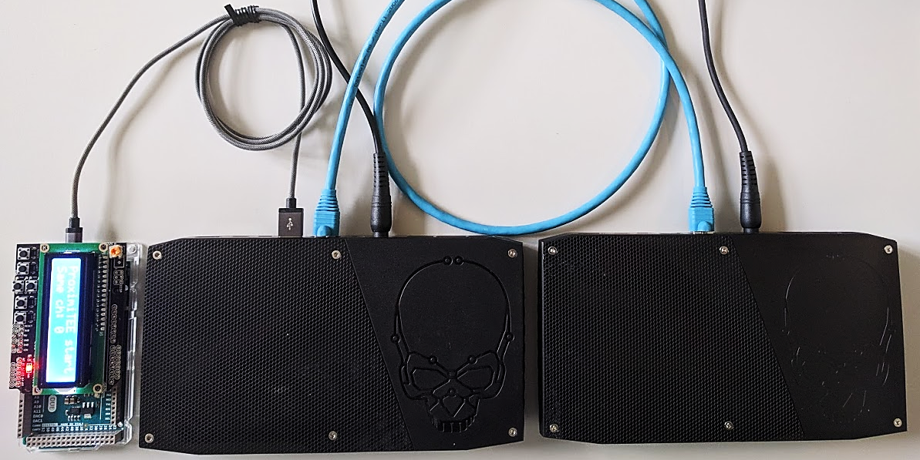
Evaluation: Setup
ProximiKey
USB 3.0 interface
1m Ethernet cable
Fully implemented
ProximiKey based on Cypress EZ-USB FX3
ProximiTEE API
Hotcalls to avoid OCALLs and ECALLs
Target platform
Attacker’s platform

Slide 73
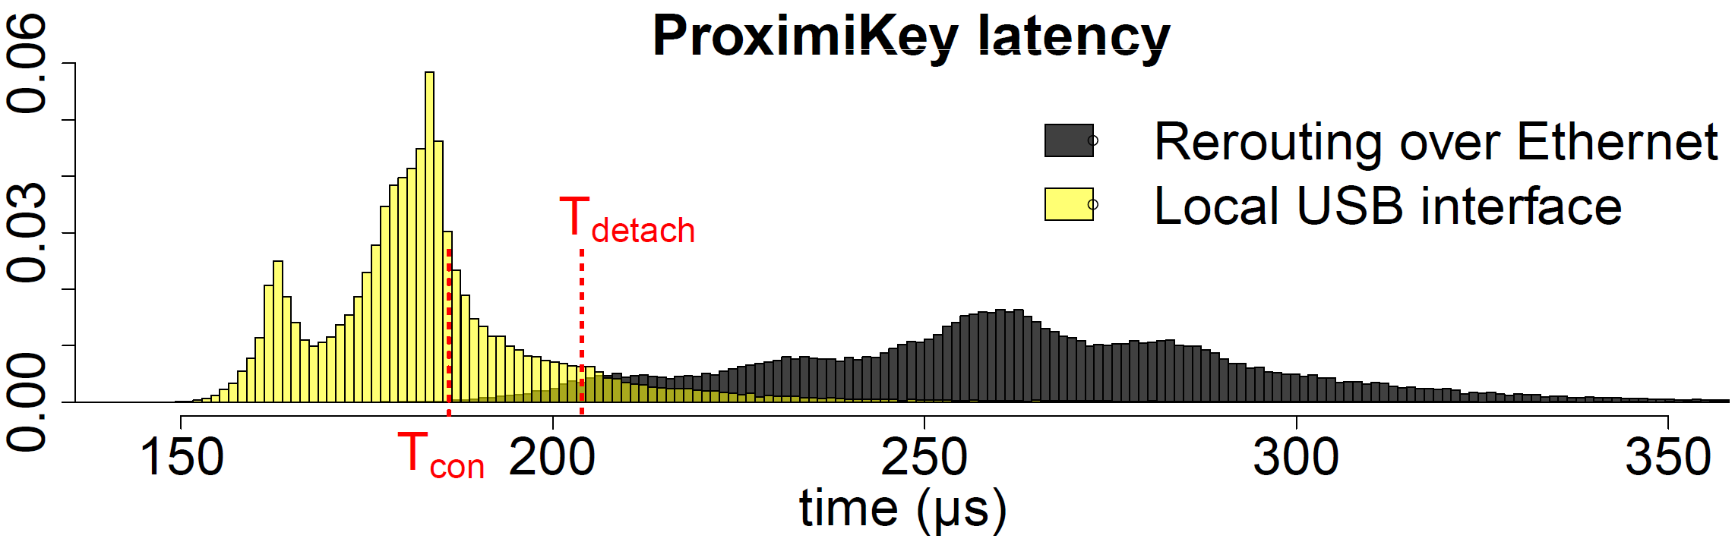
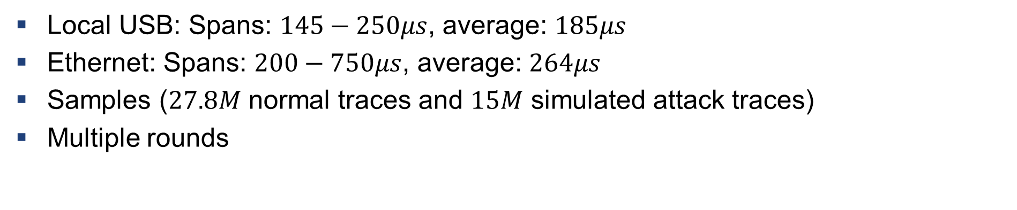
Main Experimental Result
Local USB: Spans: $145−250μs$, average: $185μs$
Ethernet: Spans: $200−750μs$, average: $264μs$
Samples ($27.8M$ normal traces and $15M$ simulated attack traces)
Multiple rounds

Slide 74
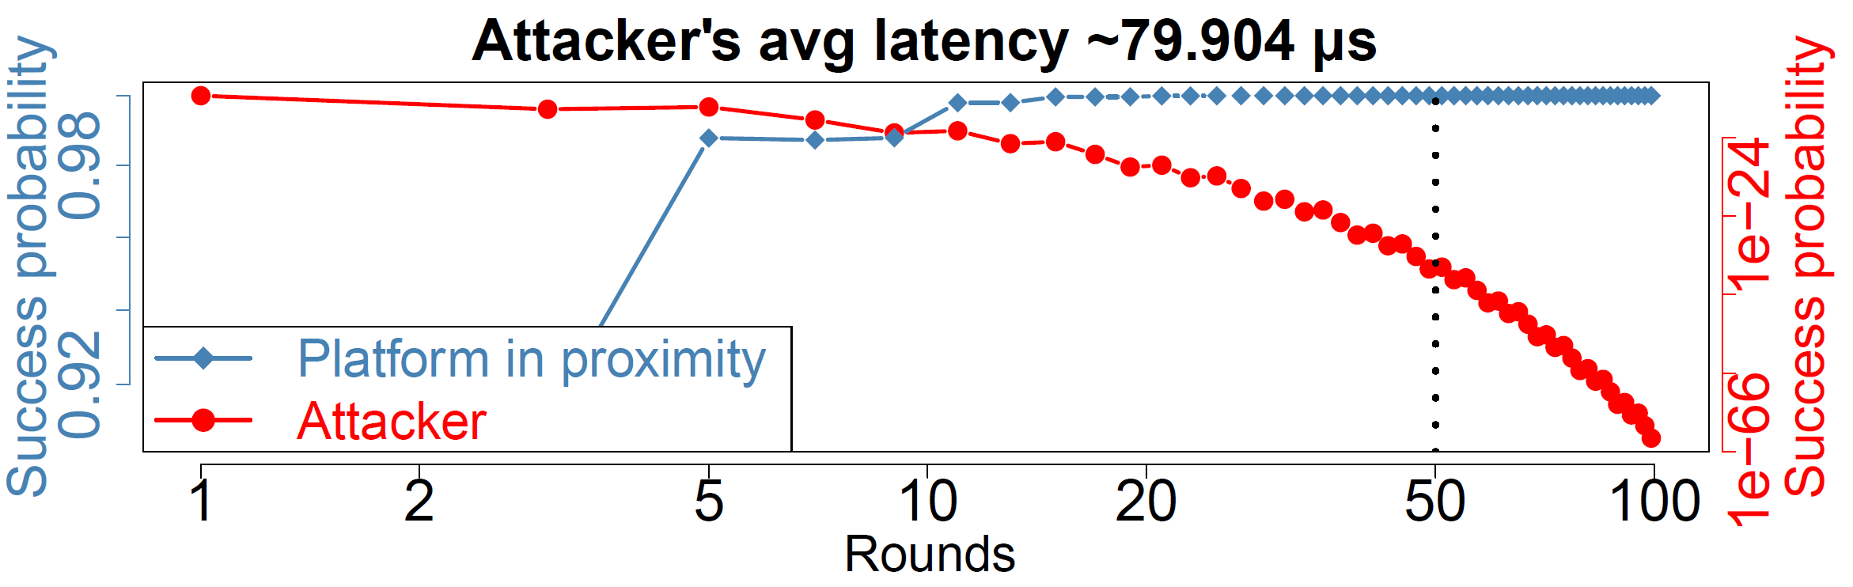
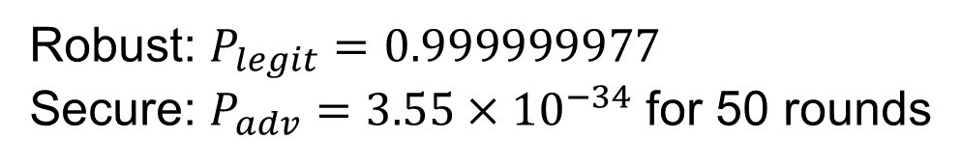
Proximity Verification Result
Robust: $P_{legit}=0.999999977$
Secure: $P_{adv}=3.55×{10}^{−34}$ for 50 rounds
Notes:
Red and blue are two different readings … attacker’s success probabilty goes down

Slide 75



Potential Use case: Trusted IO with Enclaves in Data Centre
I/O
I/O
User
User’s PC
Data center

Slide 76

Potential Use case: Setup of Permissioned Blockchain
Consensus node
Verifiers
Verifiers
Consensus node
Authority
Consensus node

Slide 77
ProtectIOn $→$ProximiTEE $→$ PIE
Remote trusted path application
Identity of the platform

Slide 78
ProtectIOn $→$ProximiTEE $→$ PIE
Driver
Remote trusted path application

Slide 79








Challenges
Secure communication
Remote attestation
Runtime attacks

Slide 80
Challenges
Secure communication
Remote attestation
Runtime attacks

Slide 81
Challenges
Secure communication
Remote attestation
Runtime attacks

Slide 82
Challenges
Secure communication
Remote attestation
Runtime attacks

Slide 83
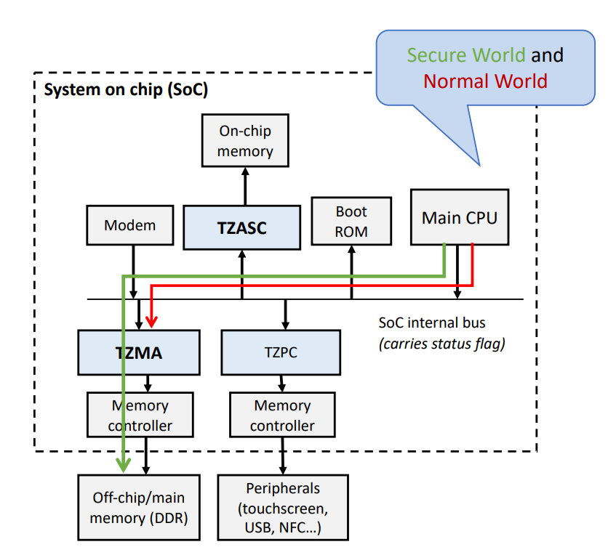
Can Existing TEEs Solve this Problem?
Can Existing TEEs Solve this Problem?
Secure world & non-secure world
App
App
Enclave
App
App
Enclave
U-mode
OS
Peripheral
OS
RT
S-mode
CPU
Peripheral
S-ROT
Security Monitor
M-mode
ARM TrustZone
Intel SGX
RISC-V KeyStone
Sanctuary
VButton
SGXIO
Graviton (SGX + nVidia GPU)
CURE

Slide 84
Challenges are needed to be adapted
Secure communication
Remote attestation
Runtime attacks

Slide 85

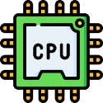





Challenges are needed to be adapted
TCB
Secure communication
Remote attestation
Runtime attacks
Least privilege

Slide 86






Attacker model
Type I : Sensors
Remote attacker
Type II : Compute Devices
Local physical attacker

Slide 87
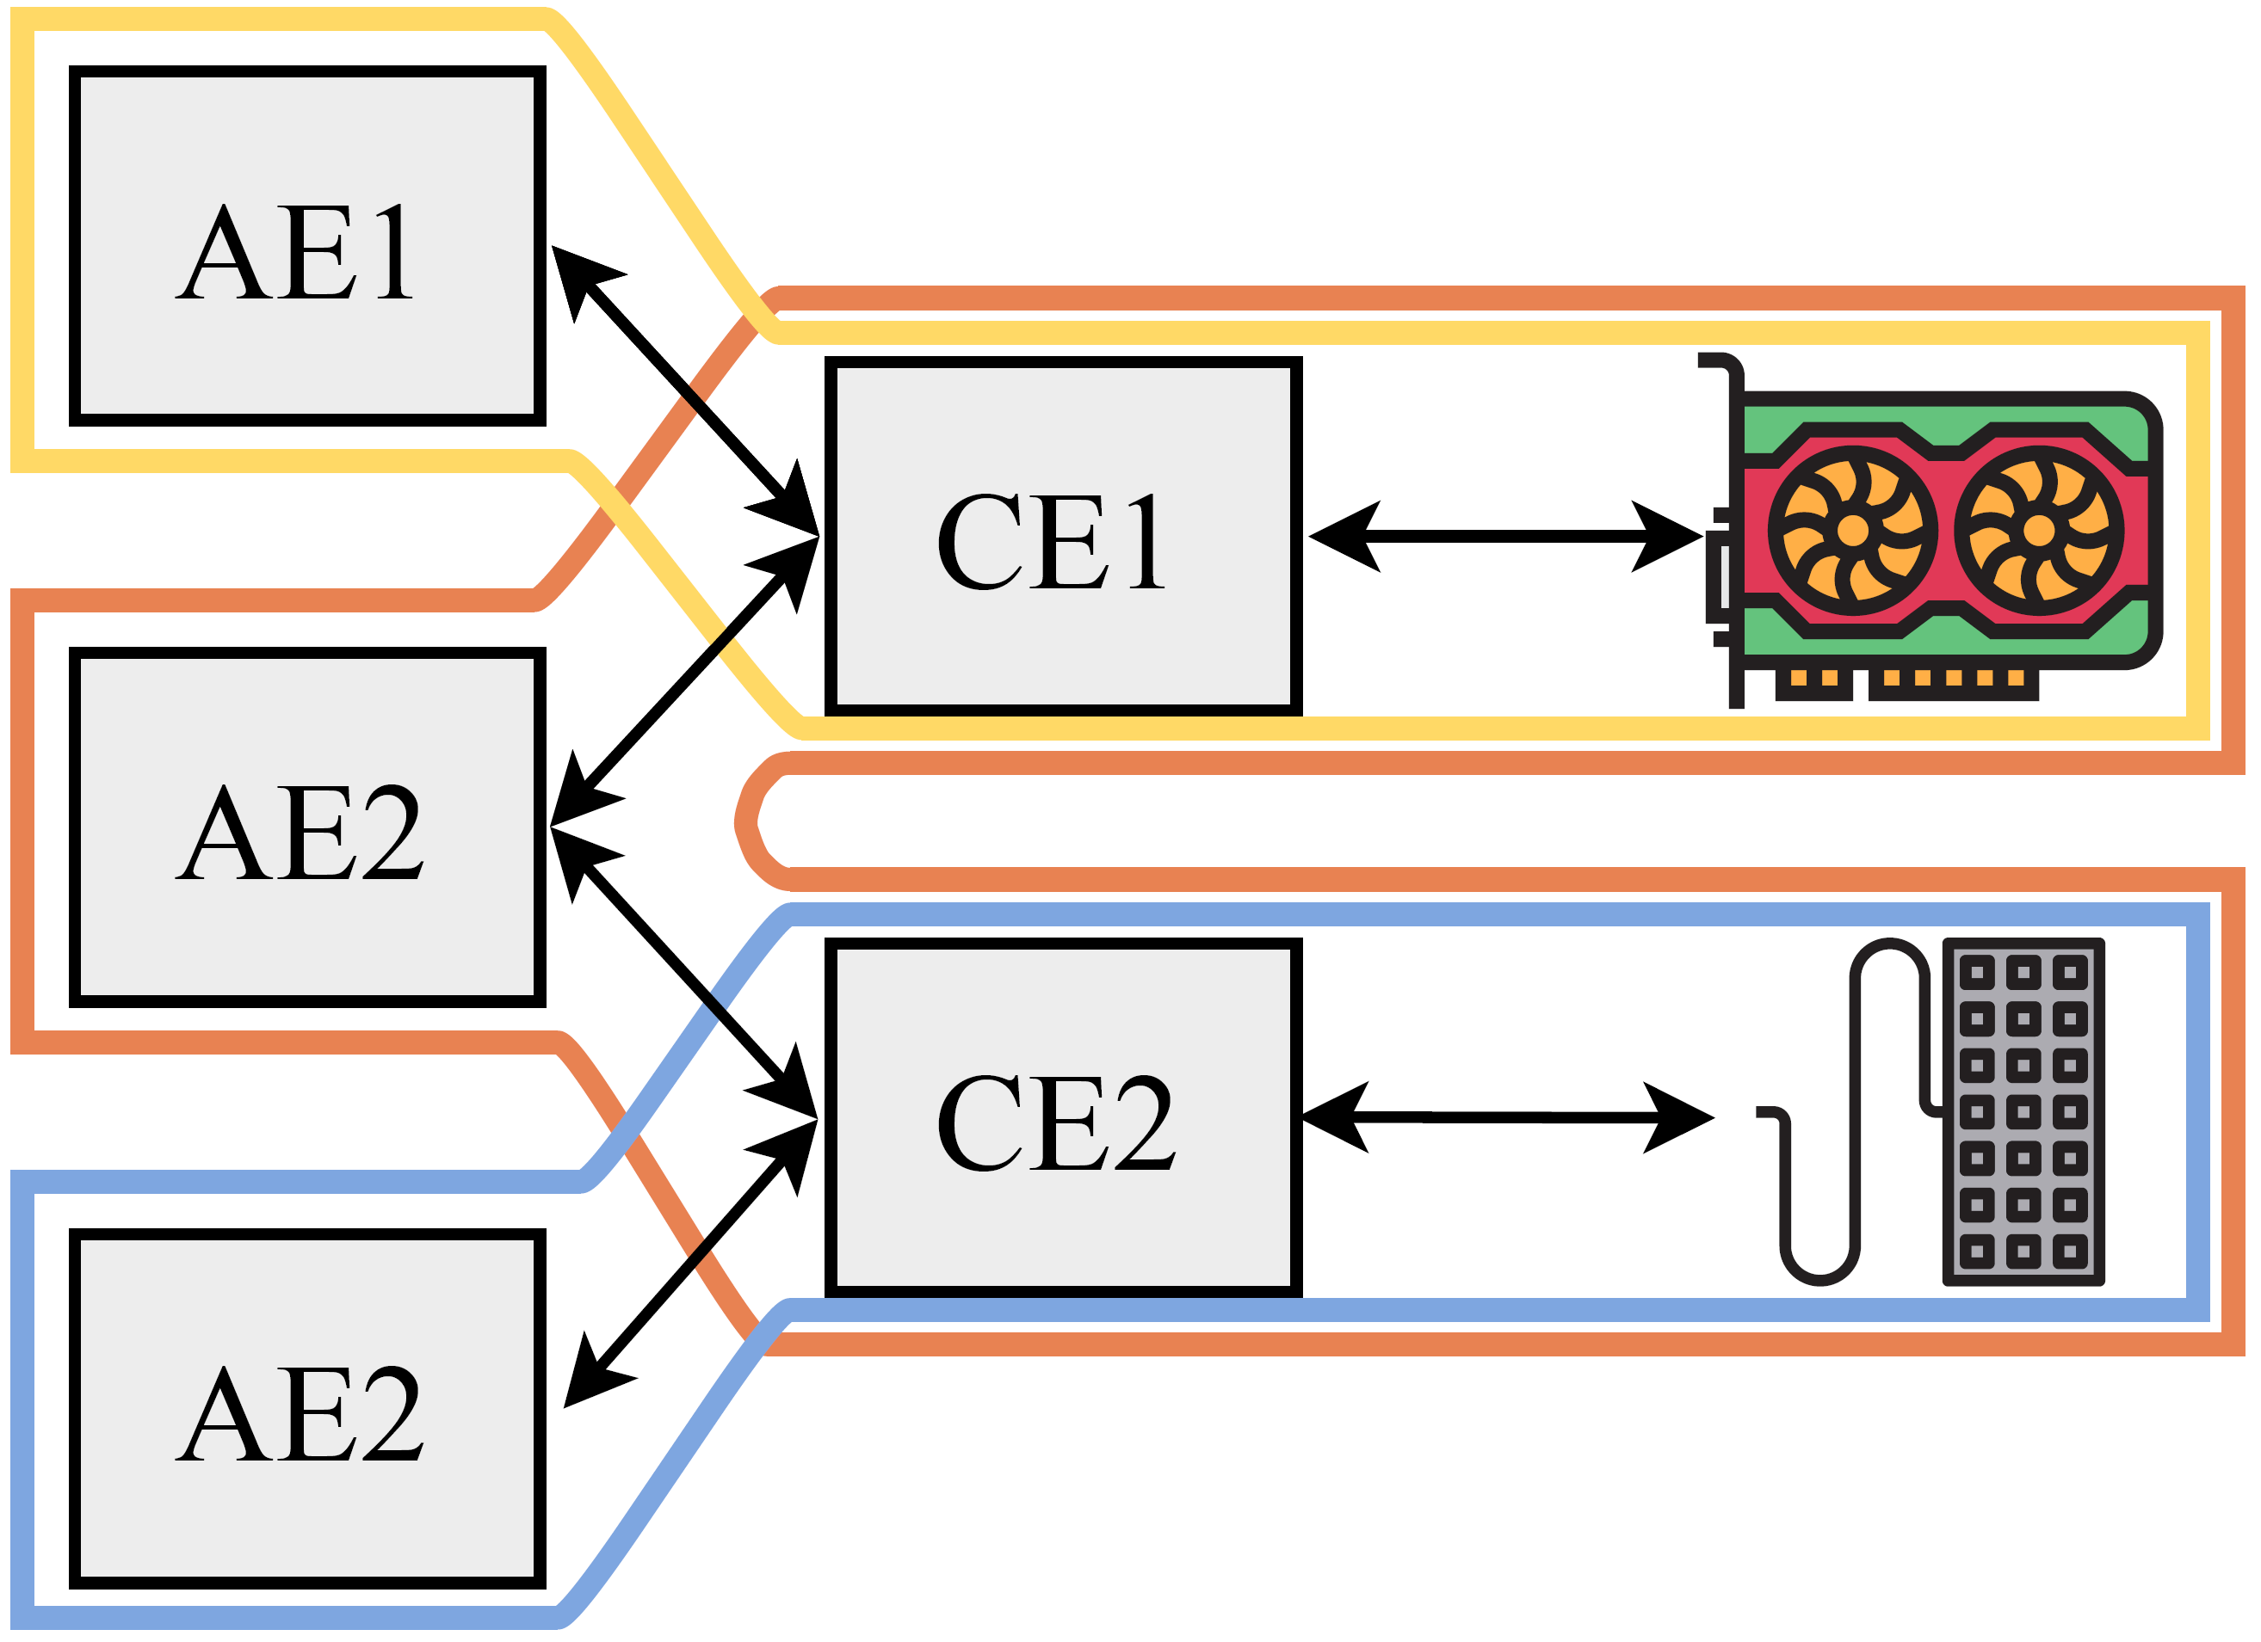

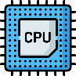

PIE
Platform-wide enclave
Three types of enclave
Application enclave
Controller enclave
Multi app isolation
Policy enforcement
Firmware enclave
Communication over shared memory
Enclave: EPC + shared buffer
Firmware enclave
Controller enclave
Application enclave
0x00
0x0FF

Slide 88
Secure Communication
App
App
Enclave
SM
RT+E
OS
Shared
OS
RT
Pmp0
000
SM
Pmp1
000
Pmp2
111
Pmp2
111

Slide 89
Secure Communication
RISC-V PMP
App
App
Enclave
SM
RT+E
OS
Shared
OS
RT
Pmp0
000
SM
Pmp1
000
Pmp2
111
Pmp2
111

Slide 90
Secure Communication
RISC-V PMP
App
App
Enclave
SM
RT+E
OS
Shared
OS
RT
Pmp0
000
SM
Pmp1
111
Pmp2
000
Pmp2
111

Slide 91
Secure Communication
RISC-V PMP
App
App
Enclave
SM
RT+E
OS
Shared
OS
RT
Pmp0
000
SM
Pmp1
111
Pmp2
000
Pmp2
111

Slide 92
Secure Communication
RISC-V PMP
App
App
Enclave
SM
RT+E
OS
Shared
OS
RT
Pmp0
000
SM
Pmp1
111
Pmp2
000
Pmp2
111

Slide 93
Secure Communication
RISC-V PMP
Use PMP entries for shared buffers
App
App
Enclave
SM
RT+E
OS
Shared
OS
RT
Pmp0
000
SM
Pmp1
000
Pmp2
111
Pmp2
111

Slide 94

Platform-awareness
Additional enclaves states
Based on moving ownership
Connect $E_{2}$: $M_{\left\{E_{1}\right\}}→M_{\{E_{1}, E_{2}\}}$
Device tree by the zero-stage bootloader
Disconnect $E_{2}$: $M_{\left\{E_{1}, E_{2}\right\}}→M_{\{E_{1}\}}$
Two types of disconnect
Synchronous
Asynchronous
Zeros out all the internal states

Slide 95


Platform-wide Attestation
Firmware
Controller enclave
Application enclave
Remote verifier
Attach
Deploy
Establish shared memory
Challenge
Firmware report
Connect
Establish shared memory
Includes connection parameters
AE report +
CE list
Remote attestation
CE + firmware report
Secret
provision
Shared memory comm
Shared memory comm

Slide 96

Summary of the properties
Platform-wide enclaves
Abstraction layer on enclaves
Distributed over CPU cores, external hardware …
Shared memory communication
Tighter control over interaction
PMP ensures isolation
Platform awareness
Lifecycle events: adapt with flexible hardware
Platform-wide attestation
Measurement + communication parameters
Least privilege on hardware TCB $→$ only trust what you use (attest)

Slide 97

Prototype: simple IO peripherals
Peripheral emulation
FPGA running application class RISC-V core with PMP
PMOD peripheral

Slide 98
Prototype: Accelerator
Multi-tenant isolation
4096-core RISC-V* accelerator based on Snitch**
Addition of PMP
Small increase in the core size
750 MHz with 0 PMP
666 MHz with 4 PMP
* Florian Zaruba, Fabian Schuiki, and Luca Benini. 2020. A 4096-core RISC-VChiplet Architecture for Ultra-efficient Floating-point Computing. In2020 IEEEHot Chips 32 Symposium (HCS). IEEE Computer Society, 1–24.
** F. Zaruba, F. Schuiki, T. Hoefler, and L. Benini. 2020.Snitch: A tinyPseudo Dual-Issue Processor for Area and Energy Efficient Executionof Floating-Point Intensive Workloads.IEEE Trans. Comput.(2020)

Slide 99

Context switch performance

Slide 100
Summary
ProtectIOn
Observation of existing trusted path systems
Fundamental security properties
A system that encapsulates all these properties
ProximiTEE
Porting trusted path solution in TEEs is non-trivial
Trust on First use in remote attestation: rerouting attack
Distance bounding to identify a platform
PIE
Disaggregate compute model
Platform-wide enclaves: extend enclaves from CPU cores to other HW
Platform awareness and platform-wide attestation

Slide 101


Thank you! Questions?

